Slide 1


North Western University, Khulna
Vehicle Management System
Course Tittle: Software Development Sessional III
Course Code:CSE-3204
1

Slide 2

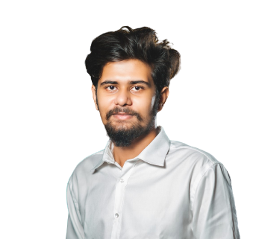
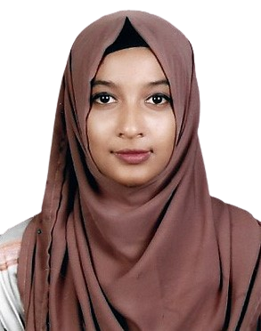

Team Name
NWU_VMS
Details Of Team Members
Md Habibullah
Student Id:20201136010
Department Of CSE
North Western University
Khulna, Bangladesh
Fatima Tuz Jahura
Student Id:20201122010
Department Of CSE
North Western University
Khulna, Bangladesh
Jyoti Biswas
Student Id:20201153010
Department Of CSE
North Western University
Khulna, Bangladesh

Slide 3
Overview
Introduction
Objective
E-R Diagram
Site Tree
Project View
Login pages
Employee Mode
Sergeant Mode
Owner Mode
Dependencies

Slide 4
Introduction
It is Software developed by python using tkinter module to handle the of BRTA Vehicle registration Process
For Adding info, view Info, update info, delete info and many other operation
Helps to crosscheck information between owner and the police sergeant with proper information

Slide 5
Objectives
Eliminate the paper work in the BRTA office
Eliminate the huge storage of Physical paper data by storing data into Database.
Simplify search and update process.
Build Digital official Interface to maintain official work digitally

Slide 6
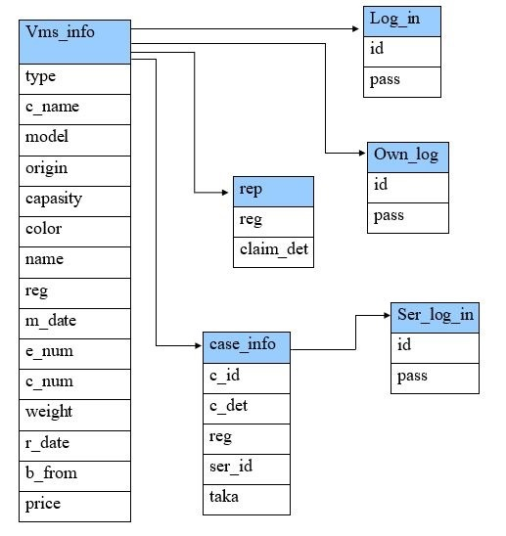
Entity Relationship Diagram
Figure: E-R Diagram of VMS

Slide 7
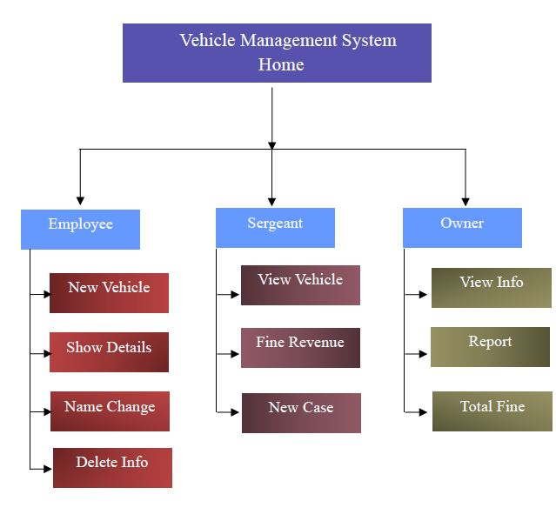
Site Tree
There are three characters. Employee, Owner, Sergeant. Each has a unique view and their own Feature.

Slide 8
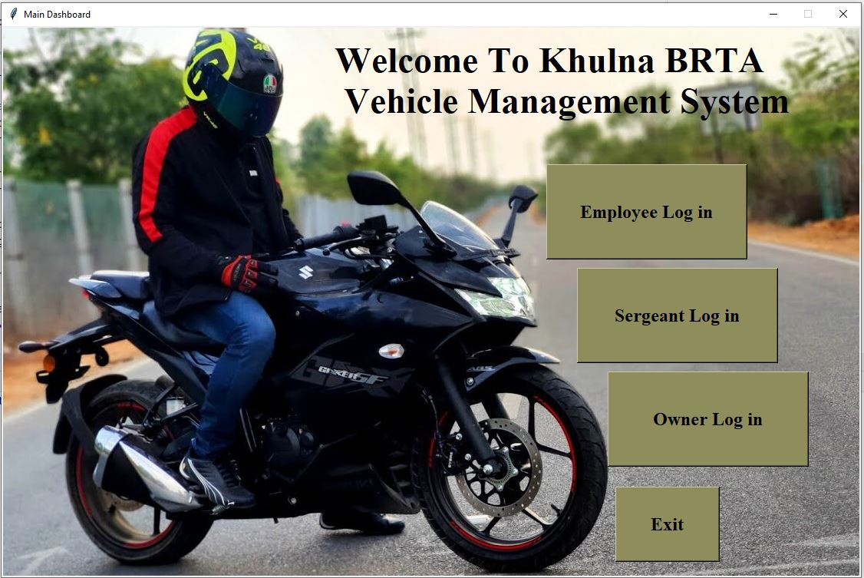
Project View
Home page of Vehicle management System.

Slide 9
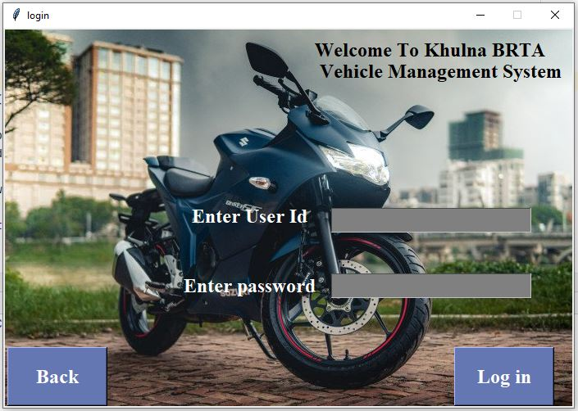
Login Pages

Slide 10
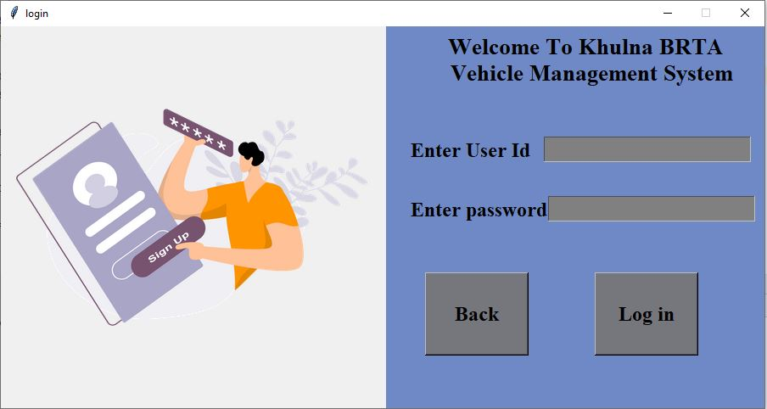
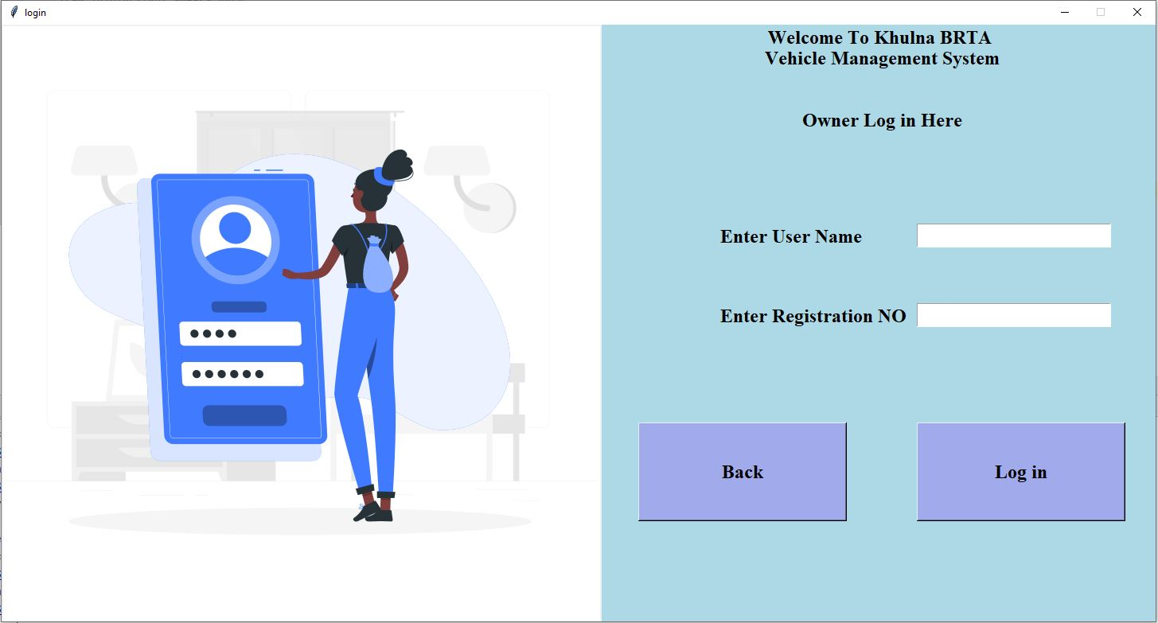


Three characters login pages
10

Slide 11
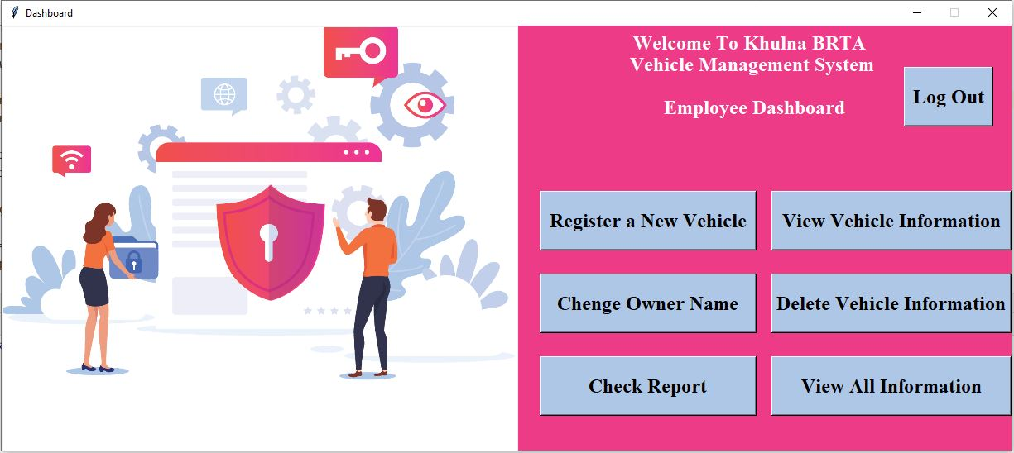
Employee Mode
Login successfully, The Employee can view the Employee dashboard of the Vehicle management system.
An Employee can Add, view, Update, Delete, check the information to the system

Slide 12
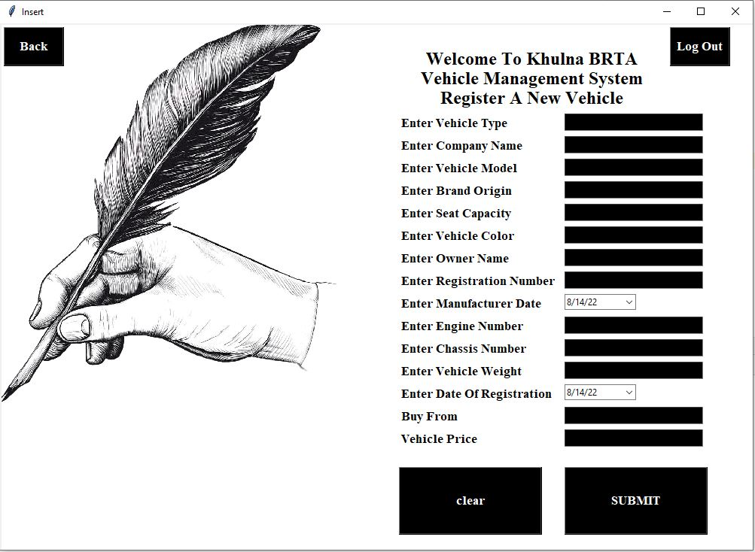
Clicking Register a New Vehicle the Employee will be able to add a new vehicle information

Slide 13
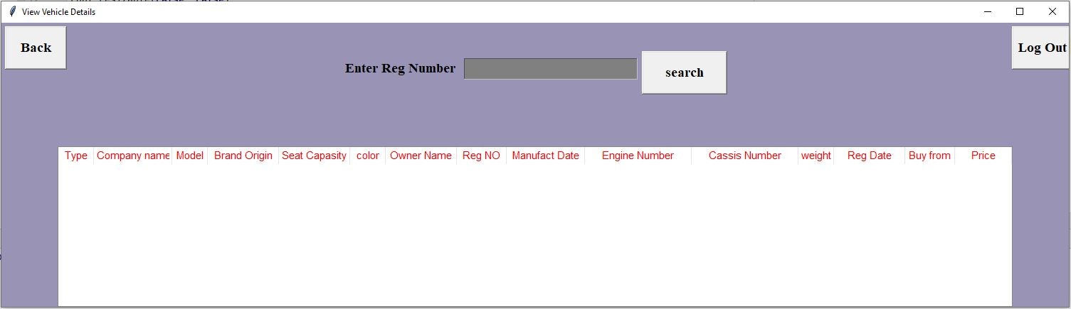
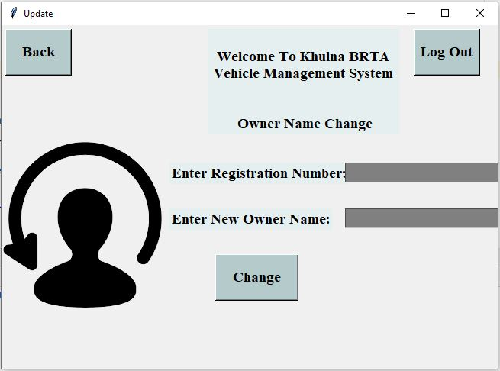
Clicking View Vehicle Information the Employee will be able to View Specific vehicle information
Clicking Change Owner Name the Employee will be able to change The Owner Name.
13

Slide 14
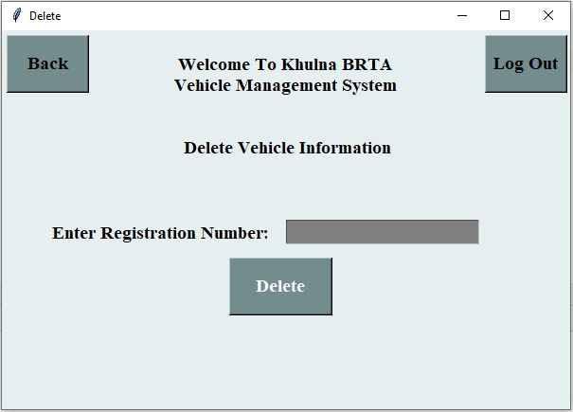
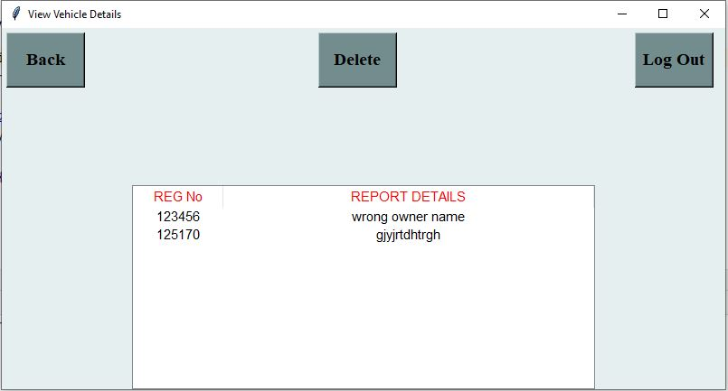
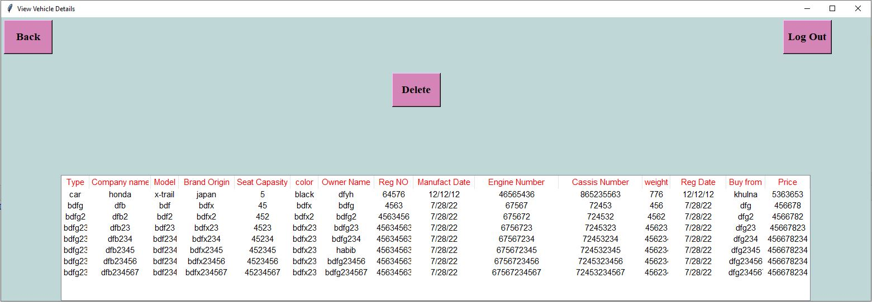
Clicking Delete Vehicle Information the Employee will be able to Delete Specific Vehicle Information
Clicking Check Report the Employee will be able to View the report which is claim by the Vehicle Owner
Clicking Check Report the Employee will be able to View the report which is claim by the Vehicle Owner
14

Slide 15
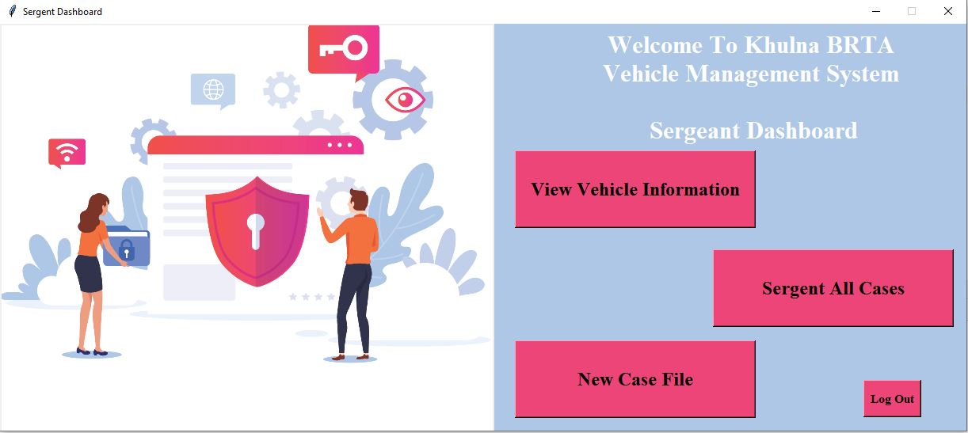
Sergeant Mode
login successfully, The Sergeant can view the Sergeant dashboard of the Vehicle management system.
a Sergeant can add, view and check the information to the system.

Slide 16
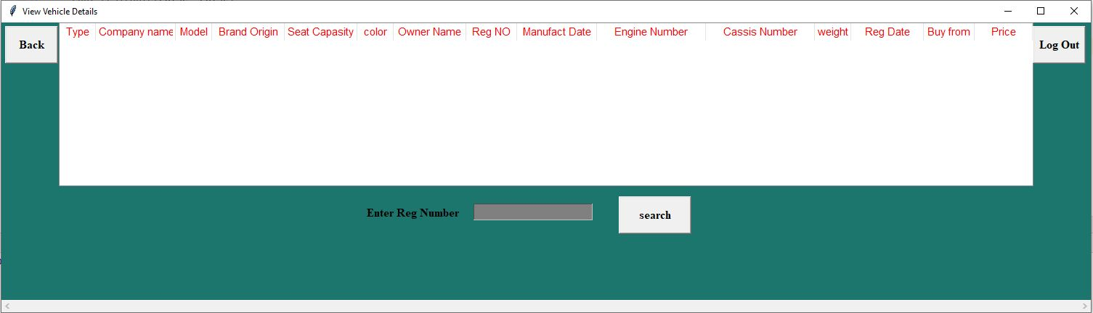
Clicking View Vehicle Information the Sergeant will be able to View Specific vehicle information searching by Registration Number
16

Slide 17
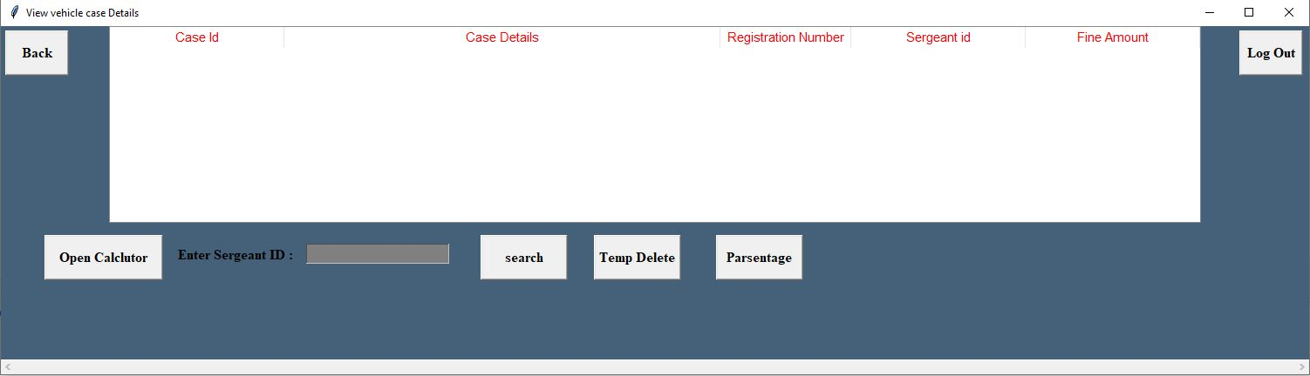
Clicking Sergeant All Case the Sergeant will be able to View All case which is noted by specific sergeant
17

Slide 18
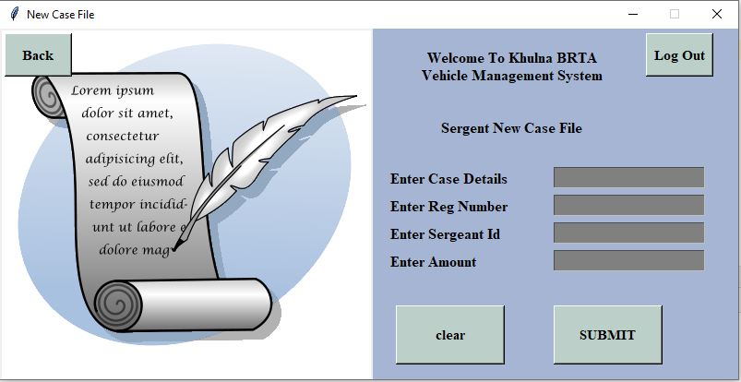
Clicking New Case File the Sergeant will be able to Note a new case.
18

Slide 19
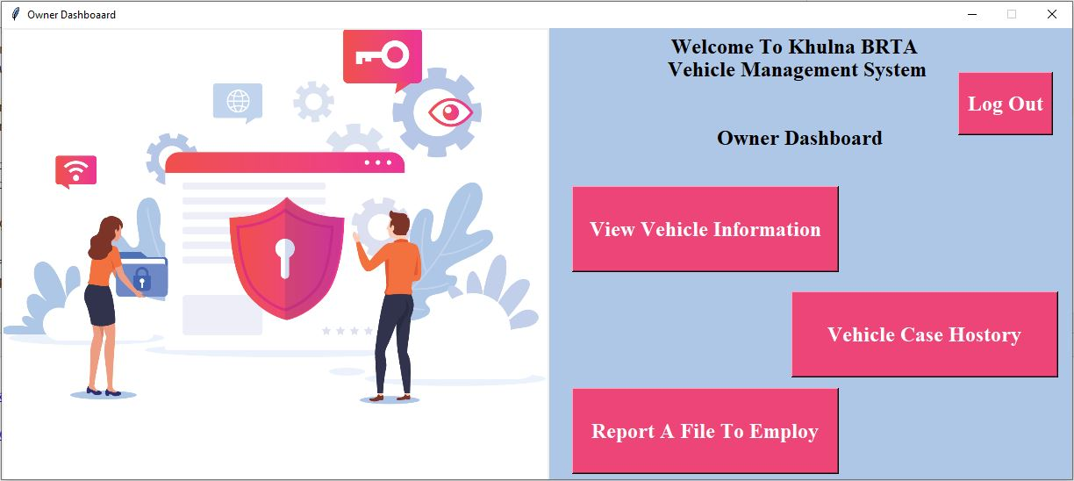
Owner Mode
login successfully, The Owner can view the Owner dashboard of the Vehicle management system.
an Owner can add Report, view and check the information to the system
i

Slide 20
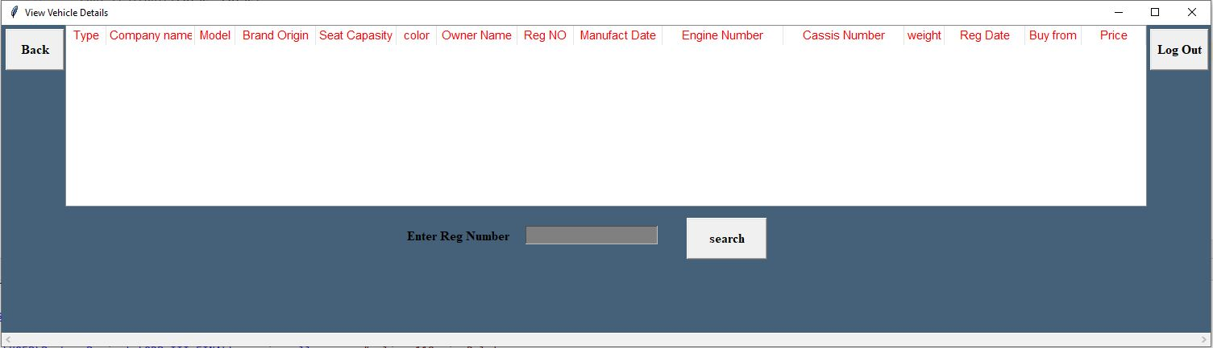
Clicking View Vehicle Information the Owner will able to View his vehicle information searching with his registration number
20

Slide 21
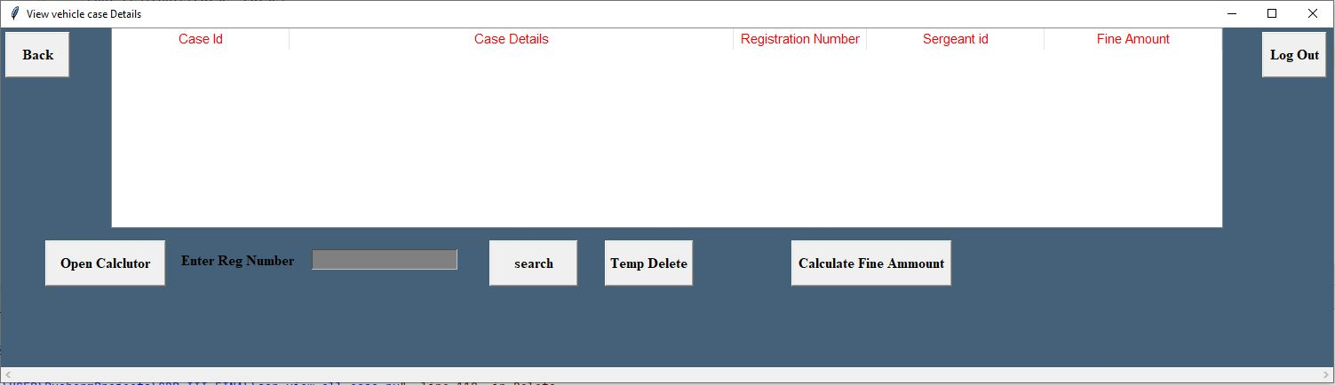
Clicking Vehicle Case History the Owner will be able to view all case which is noted for his vehicle
21

Slide 22
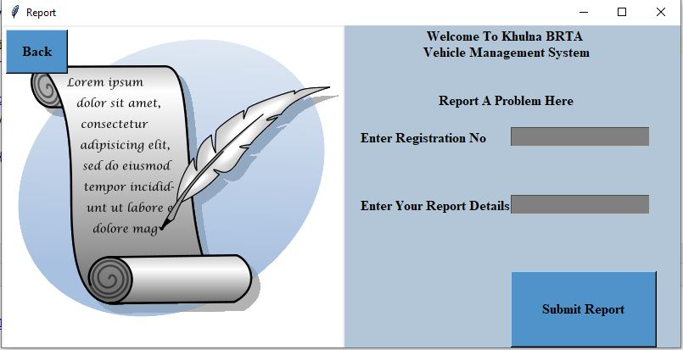
Clicking Report A file to employee the Owner will be able to note a complaint against Employee.
22

Slide 23
Dependencies:
Xampp: The Vehicle Management system (vms)’s database is Store in local server. So xampp software is needed to run this project properly
Pycharm: For built this project we use Python language and Python Built in Packages.
Tkinter: We have used Python Tkinter Module for the User Interface. So, you must have to import the Tkinter Module for successfully executing this project.
23

Slide 24
Conclusion:
The system developed with future development possibilities in consideration.
The project build digital official interface to maintain officials work digitally.
Eliminate the huge storage of Physical paper data by storing data into Database.
Simplify search and update process
24

Slide 25

Thank you

